Slide 1
COMP1860 Building our Digital World: Computer Systems & Architecture
S1.W4.L2: Karnaugh Maps
Dr James Dyer

Slide 2
Learning Outcomes
Apply minimisation of Boolean expressions to simplify logic circuits

Slide 3
Text Book
This lecture covers material similar to chapter 12 of Stallings. Computer Organisation & Architecture
  It covers Karnaugh maps (section 12.3, pages 421 to 425)

Slide 4
Overview
Karnaugh Maps

Slide 5
Minimising Circuits
To reduce the number of components
Same as minimising logical function

Slide 6
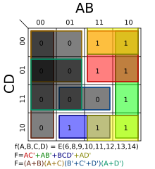
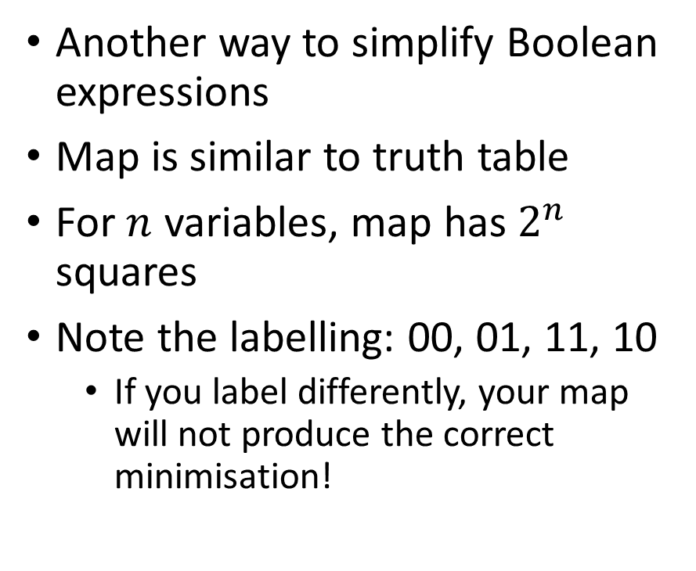
Karnaugh Maps
Another way to simplify Boolean expressions
Map is similar to truth table
For $n$ variables, map has $2^{n}$ squares
Note the labelling: 00, 01, 11, 10
  If you label differently, your map will not produce the correct minimisation!

Slide 7
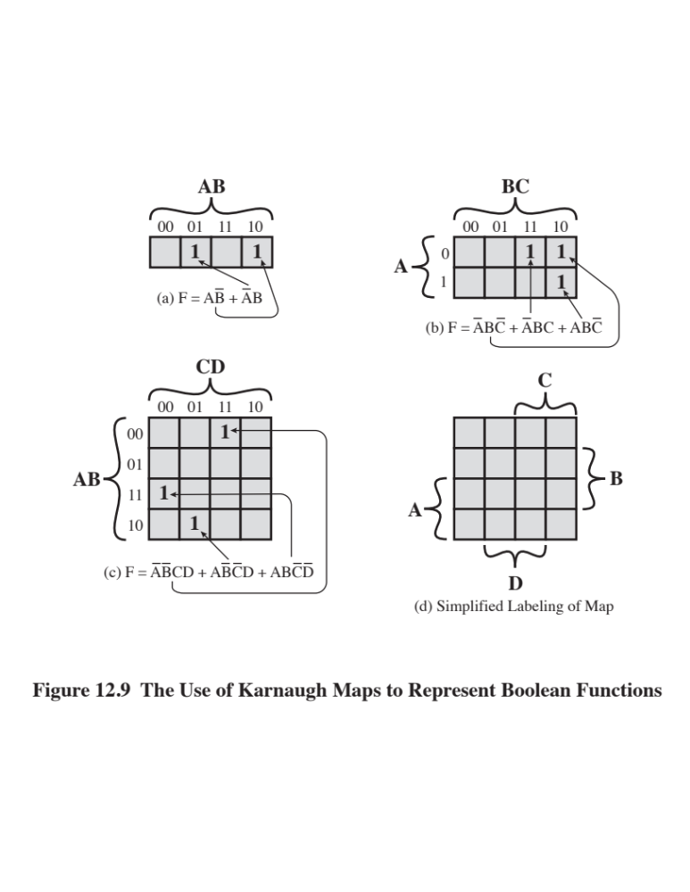
Creating a Map
2 variables (A, B)
  Single row of four entries
  Four possible values of A and B
3 variables (A, B, C)
  Rows are the two values of variable A
  Columns are the four possible values of B & C
4 variables (A, B, C, D)
  Rows are the four possible values of A & B
  Columns are the four possible values of C & D
Note that we use the sequence 00, 01 11, 10 for 2 values

Slide 8
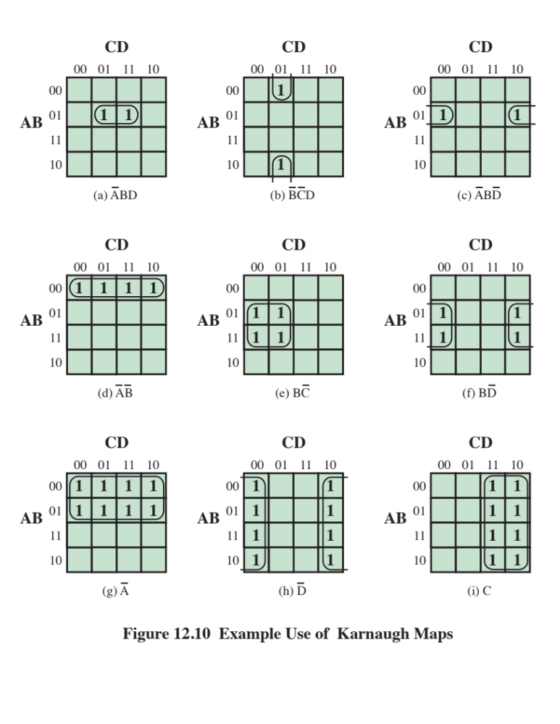
Minimising Using Karnaugh Maps (DNF)
Look for groups of adjacent 1’s in map
  Single 1s
  Lines of 1’s
  Squares or rectangles of 1’s
  Groups of size 2^{n} only: 1, 2, 4, 8, …
  Top/bottom, left/right sides wrap around (see figures b, c, f, h) when creating groups
Try to make groups as large as possible

Slide 9
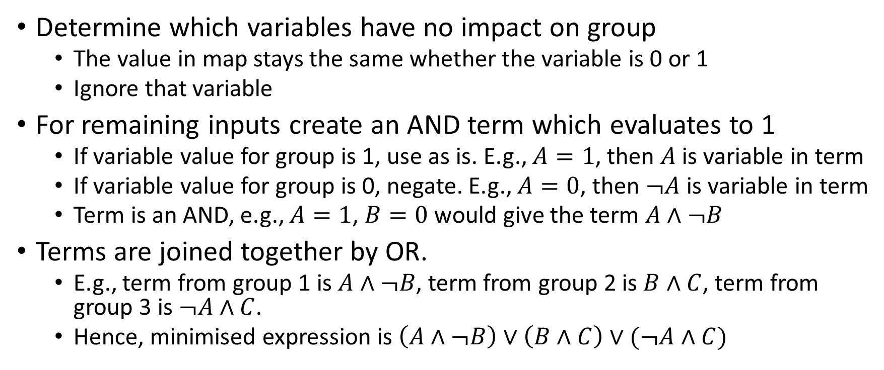
Minimising Using Karnaugh Maps (DNF)
Determine which variables have no impact on group
  The value in map stays the same whether the variable is 0 or 1
  Ignore that variable
For remaining inputs create an AND term which evaluates to 1
  If variable value for group is 1, use as is. E.g., $A=1$, then $A$ is variable in term
  If variable value for group is 0, negate. E.g., $A=0$, then $¬A$ is variable in term
  Term is an AND, e.g., $A=1$, $B=0$ would give the term $A∧¬B$
Terms are joined together by OR.
  E.g., term from group 1 is $A∧¬B$, term from group 2 is $B∧C$, term from group 3 is $¬A∧C$.
  Hence, minimised expression is $\left(A∧¬B\right)∨\left(B∧C\right)∨(¬A∧C)$

Slide 10
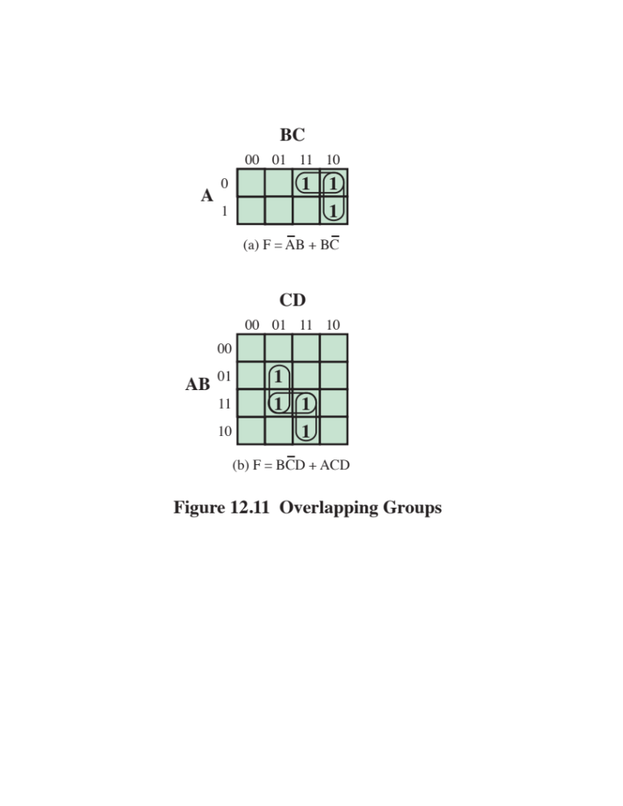
Overlapping Groups
If you have overlapping groups
Find the minimum number of largest groups to cover all 1’s (DNF) or 0’s (CNF)

Slide 11
Example 1: Create Map
A | B | C | F
0 | 0 | 0 | 0
0 | 0 | 1 | 1
0 | 1 | 0 | 0
0 | 1 | 1 | 1
1 | 0 | 0 | 0
1 | 0 | 1 | 0
1 | 1 | 0 | 1
1 | 1 | 1 | 1
A BC | 00 | 01 | 11 | 10
0 | 0 | 1 | 1 | 0
1 | 0 | 0 | 1 | 1
Arrange truth table as rectangular map
Note: Different labels on map. Be careful you transfer values correctly!

Slide 12
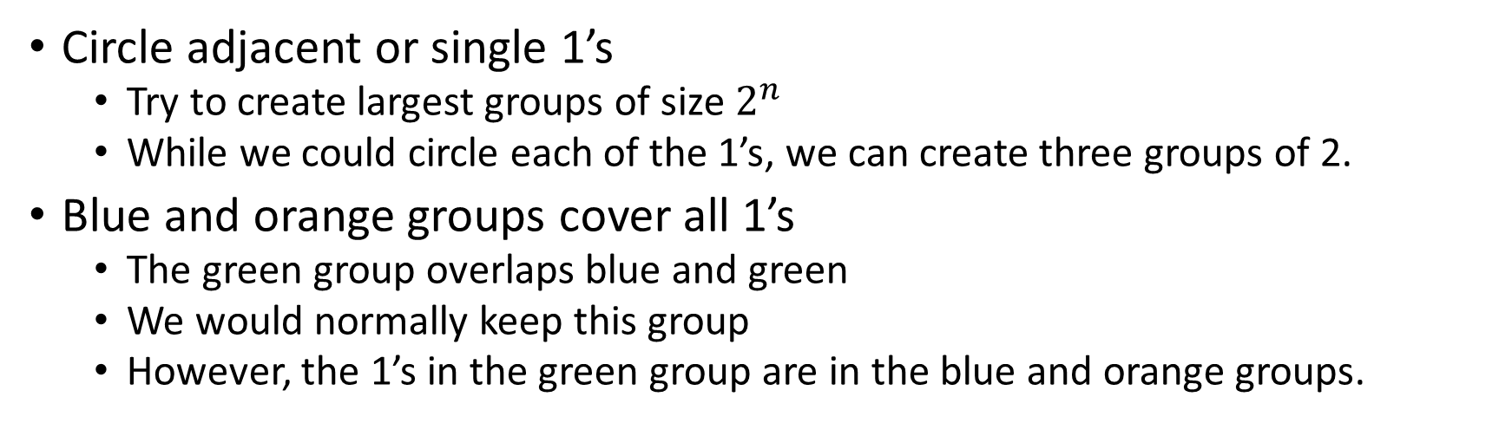
Example 1: DNF form
A BC | 00 | 01 | 11 | 10
0 | 0 | 1 | 1 | 0
1 | 0 | 0 | 1 | 1
Circle adjacent or single 1’s
  Try to create largest groups of size $2^{n}$
  While we could circle each of the 1’s, we can create three groups of 2.
Blue and orange groups cover all 1’s
  The green group overlaps blue and green
  We would normally keep this group
  However, the 1’s in the green group are in the blue and orange groups.

Slide 13
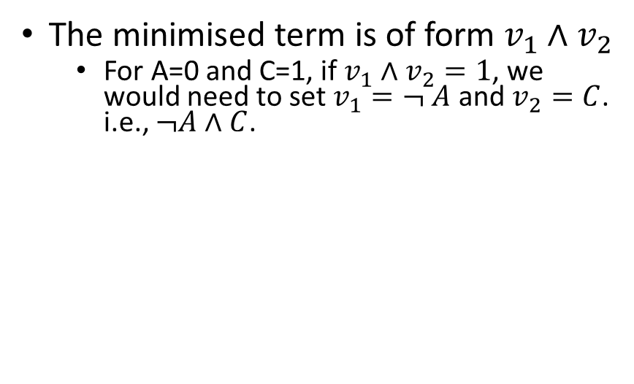
Example 1: DNF form
A BC | 00 | 01 | 11 | 10
0 | 0 | 1 | 1 | 0
1 | 0 | 0 | 1 | 1
For the blue group:
A=0, B=0 or 1, and C=1 (two values of BC, 01 and 11)
Values in group are 1, regardless whether B=0 or 1
  Therefore, variable B has no effect on the value of the expression
  Can ignore B
  Leaves A and C as part of minimised term.
The minimised term is of form $v_{1}∧v_{2}$
  For A=0 and C=1, if $v_{1}∧v_{2}=1$, we would need to set $v_{1}=¬ A$ and $v_{2}=C$. i.e., $¬A∧C$.

Slide 14
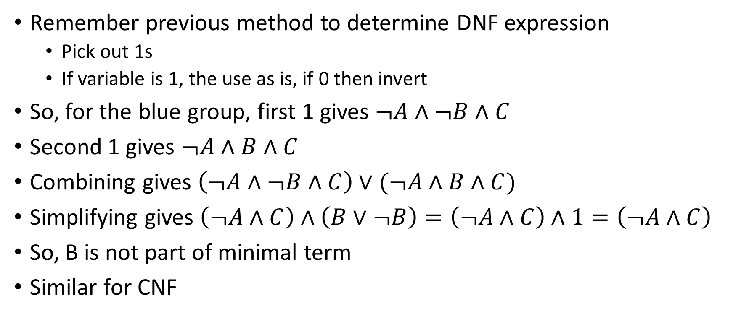
Why can we ignore variables in group?
Remember previous method to determine DNF expression
  Pick out 1s
  If variable is 1, the use as is, if 0 then invert
So, for the blue group, first 1 gives $¬A∧¬B∧C$
Second 1 gives $¬A∧B∧C$
Combining gives $\left(¬A∧¬B∧C\right)∨(¬A∧B∧C)$
Simplifying gives $\left(¬A∧C\right)∧\left(B∨¬B\right)=\left(¬A∧C\right)∧1=\left(¬A∧C\right)$
So, B is not part of minimal term
Similar for CNF

Slide 15
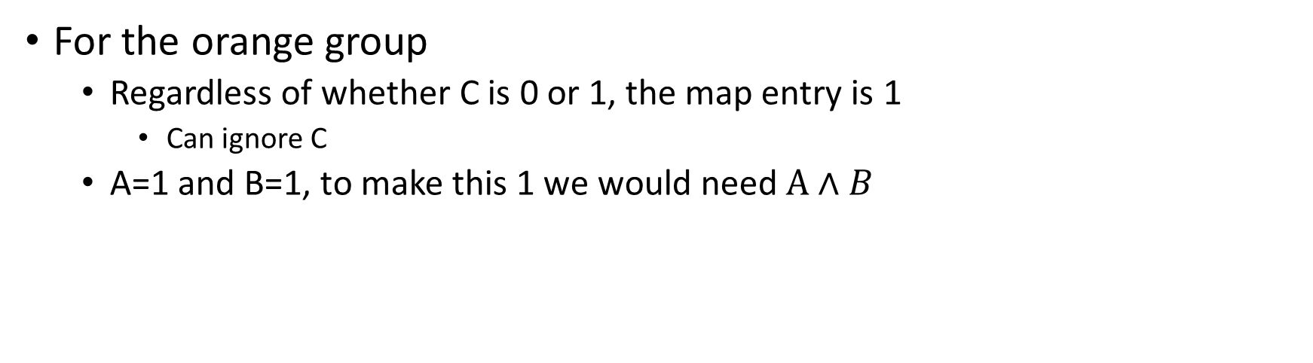
Example 1: DNF form
A BC | 00 | 01 | 11 | 10
0 | 0 | 1 | 1 | 0
1 | 0 | 0 | 1 | 1
For the orange group
  Regardless of whether C is 0 or 1, the map entry is 1
    Can ignore C
  A=1 and B=1, to make this 1 we would need $A∧B$

Slide 16
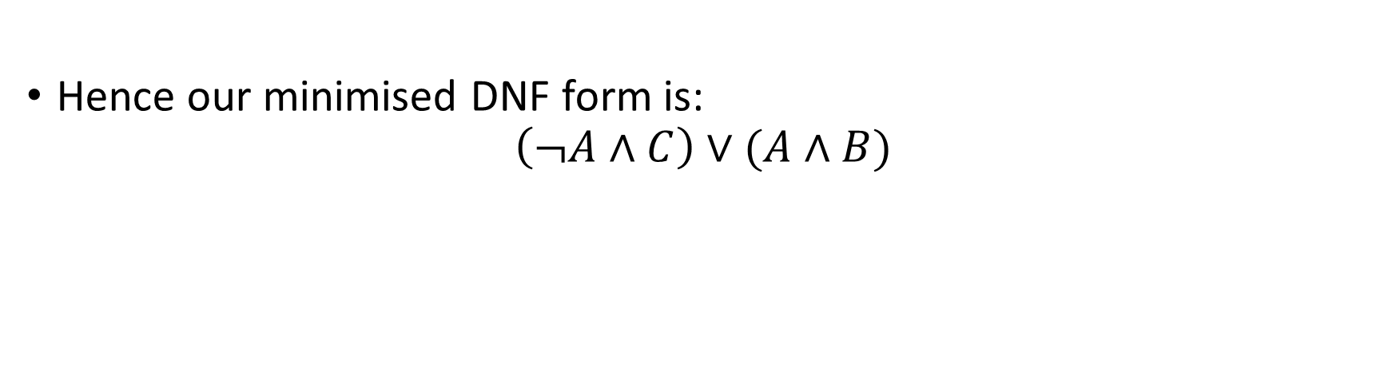
Example 1: DNF form
A BC | 00 | 01 | 11 | 10
0 | 0 | 1 | 1 | 0
1 | 0 | 0 | 1 | 1
Hence our minimised DNF form is:
$$\left(¬A∧C\right)∨(A∧B)$$

Slide 17
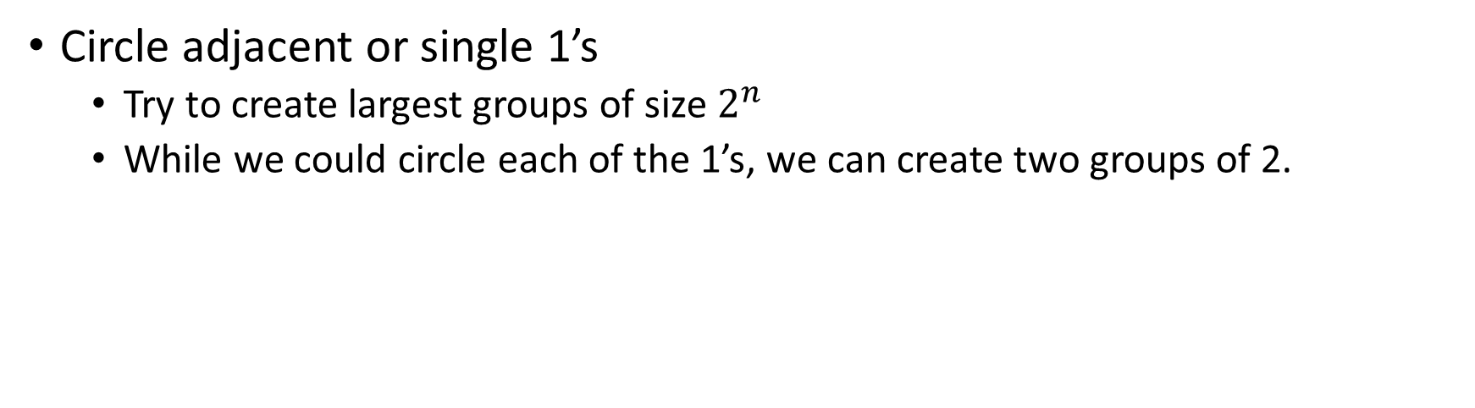
Example 2: DNF form
A BC | 00 | 01 | 11 | 10
0 | 0 | 0 | 1 | 1
1 | 0 | 0 | 0 | 1
Circle adjacent or single 1’s
  Try to create largest groups of size $2^{n}$
  While we could circle each of the 1’s, we can create two groups of 2.

Slide 18
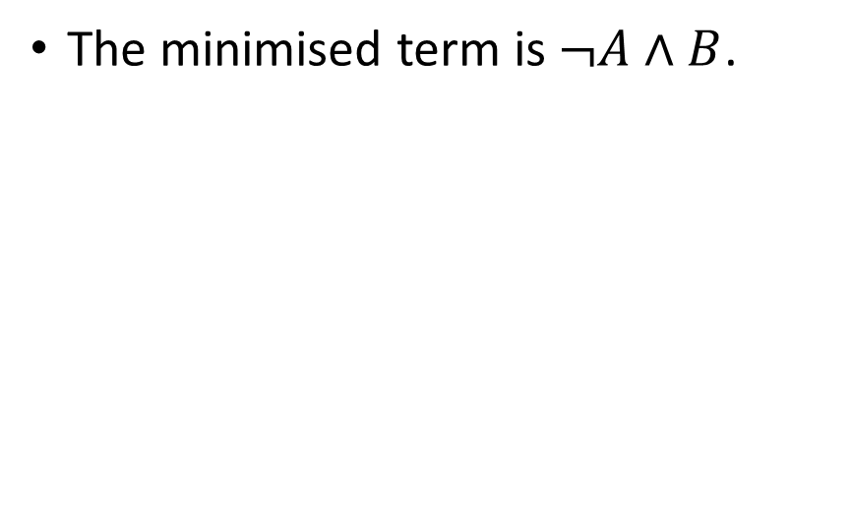
Example 2: DNF form
A BC | 00 | 01 | 11 | 10
0 | 0 | 0 | 1 | 1
1 | 0 | 0 | 0 | 1
For the blue group:
A=0, B=1, and C= 0 or 1 (two values of BC, 11 and 10)
Values in group are 1, regardless whether C=0 or 1
  Therefore, variable C has no effect on the value of the expression
  Can ignore C
The minimised term is $¬A∧B$.

Slide 19
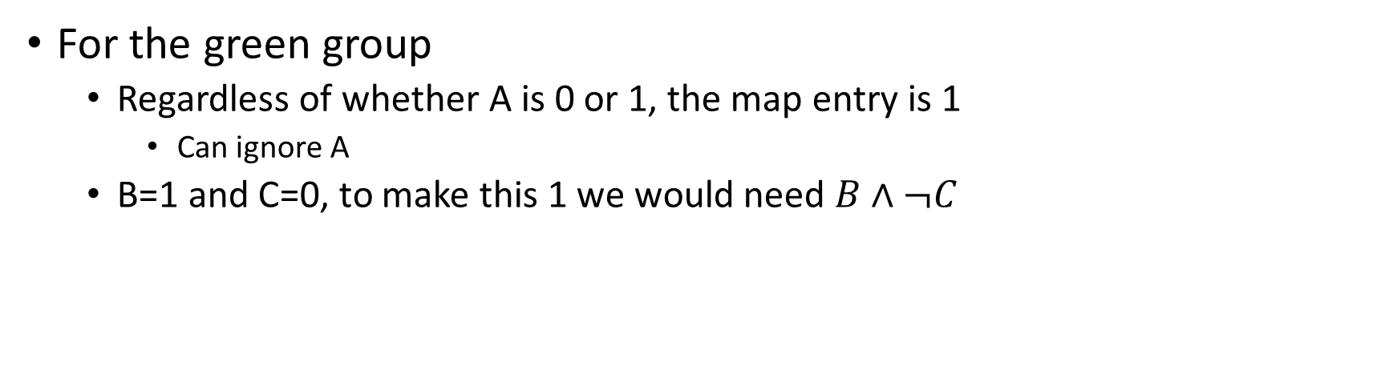
Example 2: DNF form
A BC | 00 | 01 | 11 | 10
0 | 0 | 0 | 1 | 1
1 | 0 | 0 | 0 | 1
For the green group
  Regardless of whether A is 0 or 1, the map entry is 1
    Can ignore A
  B=1 and C=0, to make this 1 we would need $B∧¬C$

Slide 20
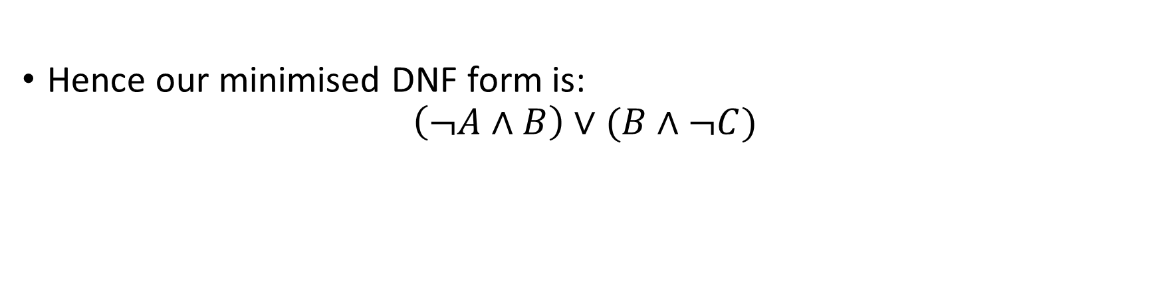
Example 2: DNF form
A BC | 00 | 01 | 11 | 10
0 | 0 | 0 | 1 | 1
1 | 0 | 0 | 0 | 1
Hence our minimised DNF form is:
$$\left(¬A∧B\right)∨(B∧¬C)$$

Slide 21
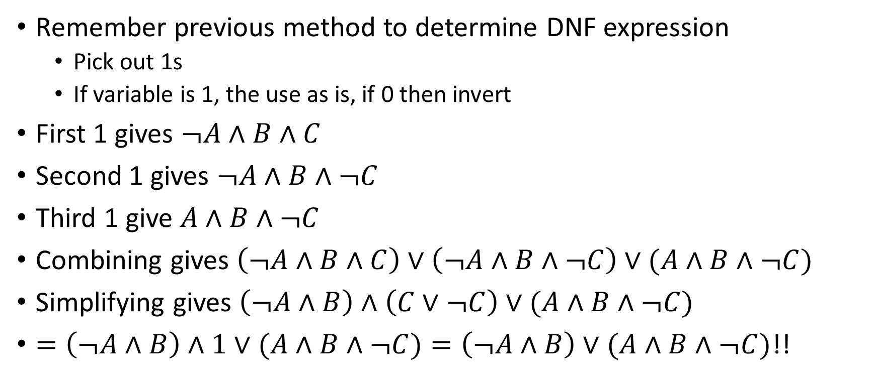
Why can we use the overlapping one twice in minimisation?
Remember previous method to determine DNF expression
  Pick out 1s
  If variable is 1, the use as is, if 0 then invert
First 1 gives $¬A∧B∧C$
Second 1 gives $¬A∧B∧¬C$
Third 1 give $A∧B∧¬C$
Combining gives $\left(¬A∧B∧C\right)∨\left(¬A∧B∧¬C\right)∨(A∧B∧¬C)$
Simplifying gives $\left(¬A∧B\right)∧\left(C∨¬C\right)∨(A∧B∧¬C)$
$=\left(¬A∧B\right)∧1∨(A∧B∧¬C)=\left(¬A∧B\right)∨(A∧B∧¬C)$!!

Slide 22
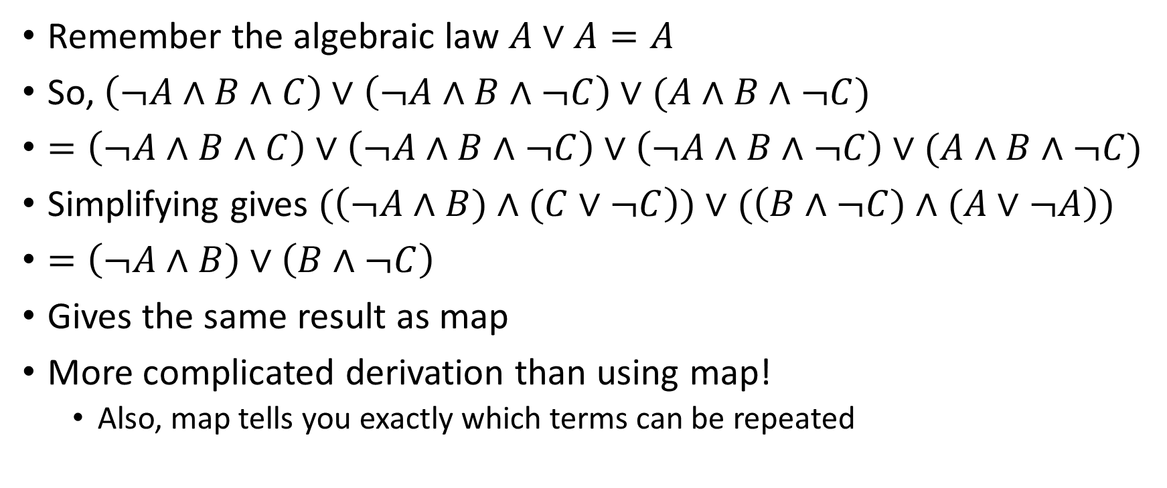
However
Remember the algebraic law $A∨A=A$
So, $\left(¬A∧B∧C\right)∨\left(¬A∧B∧¬C\right)∨(A∧B∧¬C)$
$=\left(¬A∧B∧C\right)∨\left(¬A∧B∧¬C\right)∨\left(¬A∧B∧¬C\right)∨(A∧B∧¬C)$
Simplifying gives $(\left(¬A∧B)∧(C∨¬C\right))∨(\left(B∧¬C)∧(A∨¬A\right))$
$=\left(¬A∧B\right)∨\left(B∧¬C\right)$
Gives the same result as map
More complicated derivation than using map!
  Also, map tells you exactly which terms can be repeated

Slide 23
Example 3: DNF
AB CD | 00 | 01 | 11 | 10
00 | 0 | 0 | 1 | 1
01 | 0 | 0 | 1 | 1
11 | 1 | 0 | 1 | 1
10 | 0 | 0 | 1 | 1
Enclose groups of 1’s
Note largest groups of adjacent 1’s are group of 8 and group of 2.

Slide 24
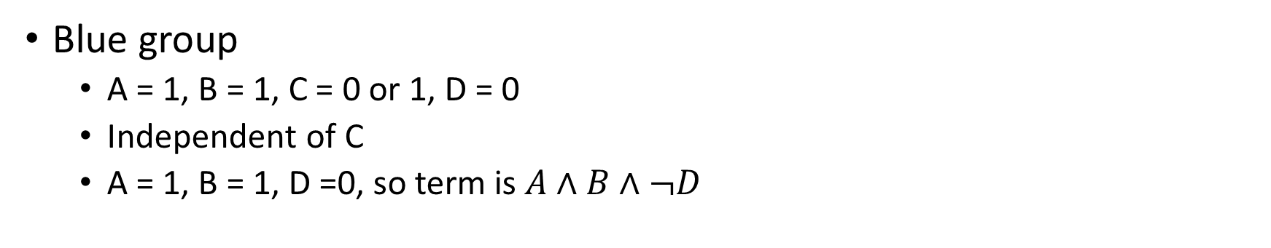
Example 3: DNF
AB CD | 00 | 01 | 11 | 10
00 | 0 | 0 | 1 | 1
01 | 0 | 0 | 1 | 1
11 | 1 | 0 | 1 | 1
10 | 0 | 0 | 1 | 1
Blue group
  A = 1, B = 1, C = 0 or 1, D = 0
  Independent of C
  A = 1, B = 1, D =0, so term is $A∧B∧¬D$

Slide 25
Example 3: DNF
AB CD | 00 | 01 | 11 | 10
00 | 0 | 0 | 1 | 1
01 | 0 | 0 | 1 | 1
11 | 1 | 0 | 1 | 1
10 | 0 | 0 | 1 | 1
Orange group
  A = 0 or 1, B = 0 or 1, C = 1, D = 0 or 1.
  Value is 1 independent of A, B and D input.
  C=1, so term is C

Slide 26
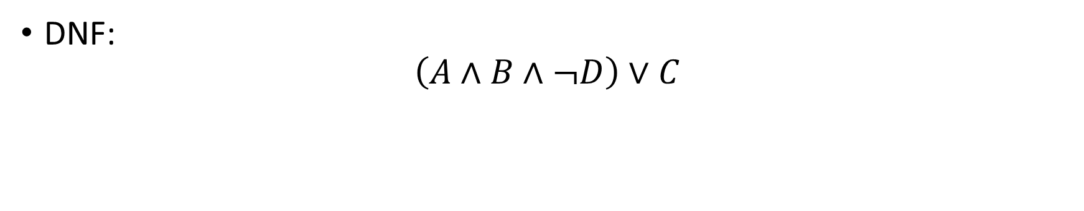
Example 3: DNF
AB CD | 00 | 01 | 11 | 10
00 | 0 | 0 | 1 | 1
01 | 0 | 0 | 1 | 1
11 | 1 | 0 | 1 | 1
10 | 0 | 0 | 1 | 1
DNF:
$$\left(A∧B∧¬D\right)∨C$$

Slide 27
Exercise 1
Minimize the Boolean expressions represented by the following Karnaugh Maps in DNF form:
A BC | 00 | 01 | 11 | 10
0 | 1 | 0 | 0 | 1
1 | 0 | 1 | 1 | 1
AB CD | 00 | 01 | 11 | 10
00 | 1 | 1 | 1 | 1
01 | 1 | 1 | 1 | 1
11 | 0 | 0 | 1 | 1
10 | 0 | 0 | 1 | 1

Slide 28
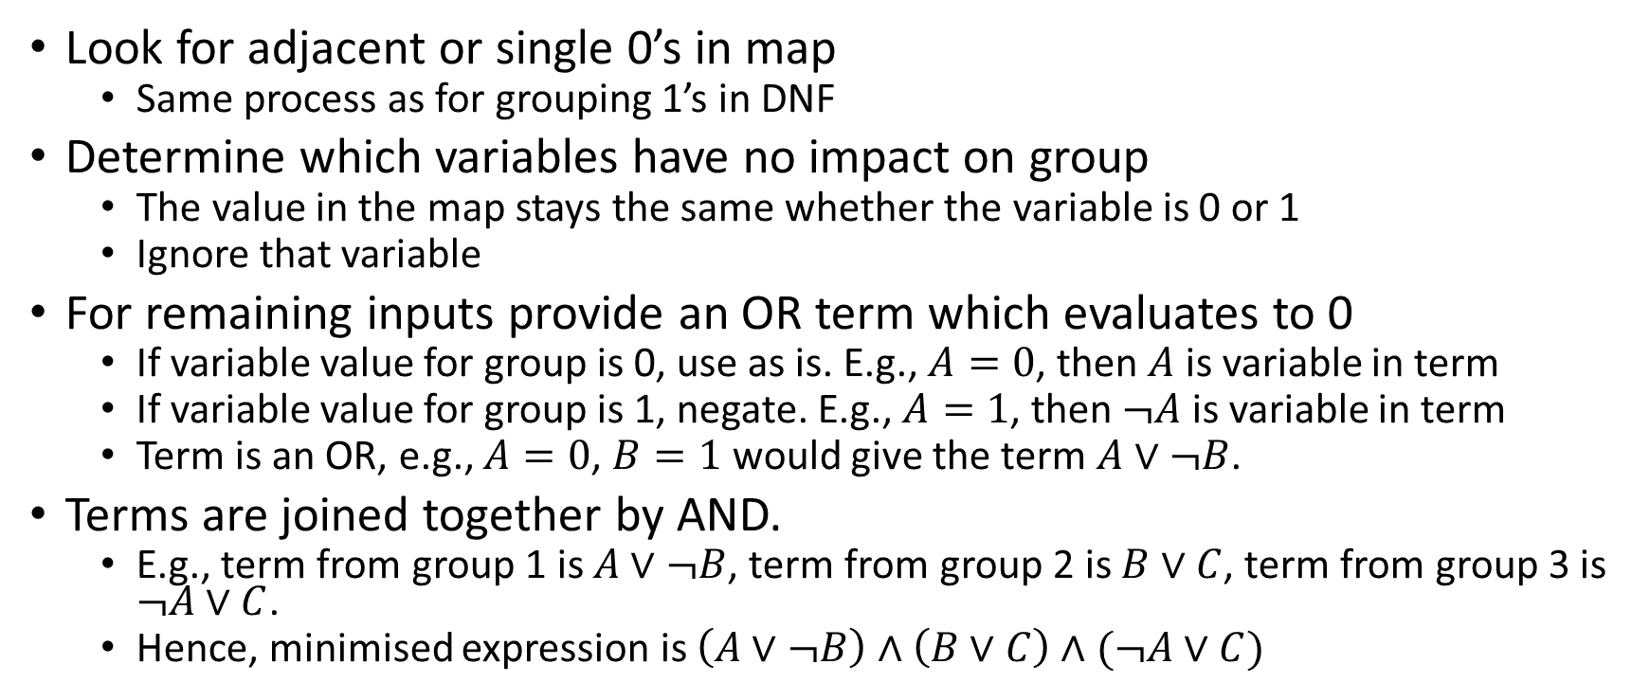
Minimising Using Karnaugh Maps (CNF)
Look for adjacent or single 0’s in map
  Same process as for grouping 1’s in DNF
Determine which variables have no impact on group
  The value in the map stays the same whether the variable is 0 or 1
  Ignore that variable
For remaining inputs provide an OR term which evaluates to 0
  If variable value for group is 0, use as is. E.g., $A=0$, then $A$ is variable in term
  If variable value for group is 1, negate. E.g., $A=1$, then $¬A$ is variable in term
  Term is an OR, e.g., $A=0$, $B=1$ would give the term $A∨¬B$.
Terms are joined together by AND.
  E.g., term from group 1 is $A∨¬B$, term from group 2 is $B∨C$, term from group 3 is $¬A∨C$.
  Hence, minimised expression is $\left(A∨¬B\right)∧\left(B∨C\right)∧(¬A∨C)$

Slide 29
Example 1: CNF form
A BC | 00 | 01 | 11 | 10
0 | 0 | 1 | 1 | 0
1 | 0 | 0 | 1 | 1
Circle adjacent or single 0’s
  Might seem like top right 0 is single.
  However, it wraps to the top left 0 to create a group of 2.
Blue and green groups covers all zeroes.

Slide 30
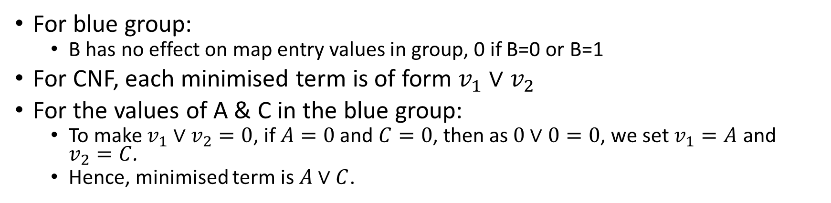
Example 1: CNF form
A BC | 00 | 01 | 11 | 10
0 | 0 | 1 | 1 | 0
1 | 0 | 0 | 1 | 1
For blue group:
  B has no effect on map entry values in group, 0 if B=0 or B=1
For CNF, each minimised term is of form $v_{1}∨v_{2}$
For the values of A & C in the blue group:
  To make $v_{1}∨v_{2}=0$, if $A=0$ and $C=0$, then as $0∨0=0$, we set $v_{1}=A$ and $v_{2}=C$.
  Hence, minimised term is $A∨C$.

Slide 31
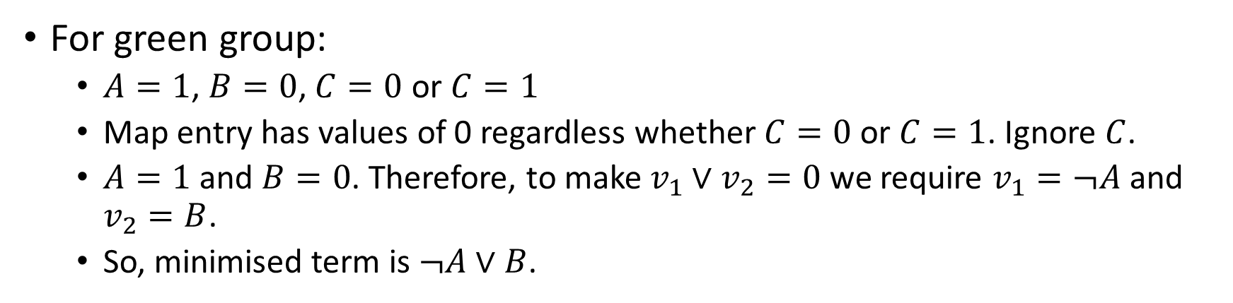
Example 1: CNF form
A BC | 00 | 01 | 11 | 10
0 | 0 | 1 | 1 | 0
1 | 0 | 0 | 1 | 1
For green group:
  $A=1$, $B=0$, $C=0$ or $C=1$
  Map entry has values of 0 regardless whether $C=0$ or $C=1$. Ignore $C$.
  $A=1$ and $B=0$. Therefore, to make $v_{1}∨v_{2}=0$ we require $v_{1}=¬A$ and $v_{2}=B$.
  So, minimised term is $¬A∨B$.

Slide 32
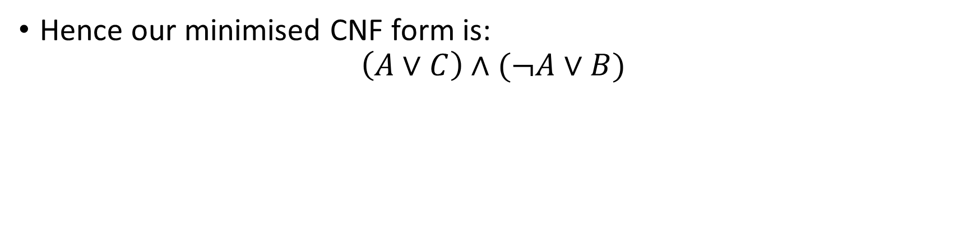
Example 1: CNF form
A BC | 00 | 01 | 11 | 10
0 | 0 | 1 | 1 | 0
1 | 0 | 0 | 1 | 1
Hence our minimised CNF form is:
$$\left(A∨C\right)∧(¬A∨B)$$

Slide 33
Example 2: CNF form
A BC | 00 | 01 | 11 | 10
0 | 0 | 0 | 1 | 1
1 | 0 | 0 | 0 | 1
Circle adjacent or single 0’s
  Might seem like furthest right 0 is single.
  However, it can be made part of a group of 2 by overlapping.

Slide 34
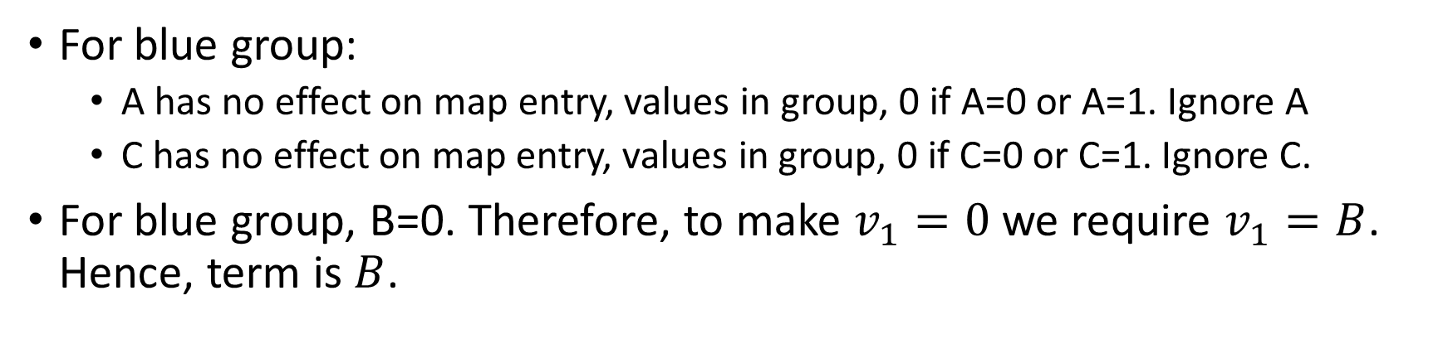
Example 2: CNF form
A BC | 00 | 01 | 11 | 10
0 | 0 | 0 | 1 | 1
1 | 0 | 0 | 0 | 1
For blue group:
  A has no effect on map entry, values in group, 0 if A=0 or A=1. Ignore A
  C has no effect on map entry, values in group, 0 if C=0 or C=1. Ignore C.
For blue group, B=0. Therefore, to make $v_{1}=0$ we require $v_{1}=B$. Hence, term is $B$.

Slide 35
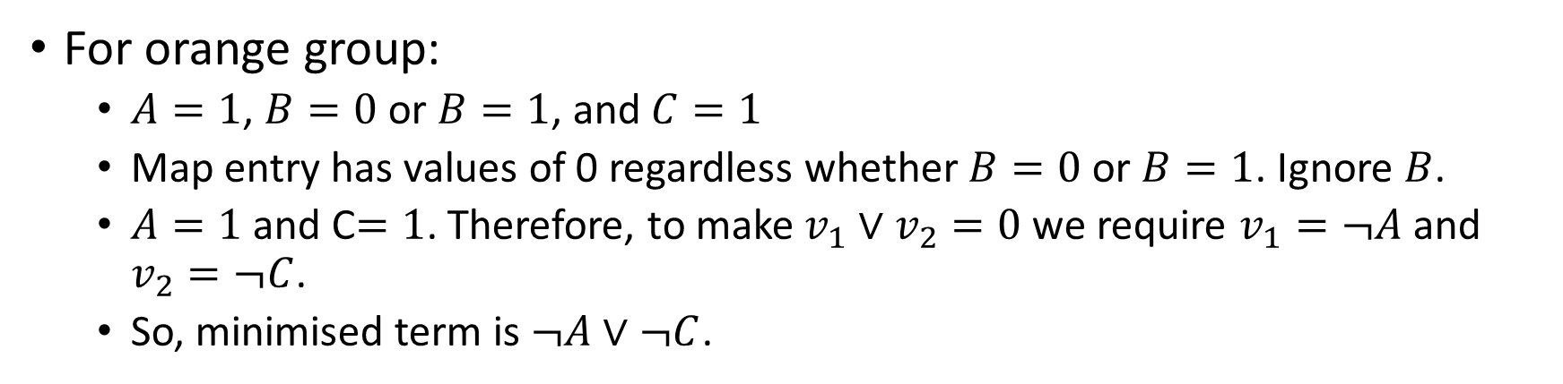
Example 2: CNF form
A BC | 00 | 01 | 11 | 10
0 | 0 | 0 | 1 | 1
1 | 0 | 0 | 0 | 1
For orange group:
  $A=1$, $B=0$ or $B=1$, and $C=1$
  Map entry has values of 0 regardless whether $B=0$ or $B=1$. Ignore $B$.
  $A=1$ and C$=1$. Therefore, to make $v_{1}∨v_{2}=0$ we require $v_{1}=¬A$ and $v_{2}=¬C$.
  So, minimised term is $¬A∨¬C$.

Slide 36
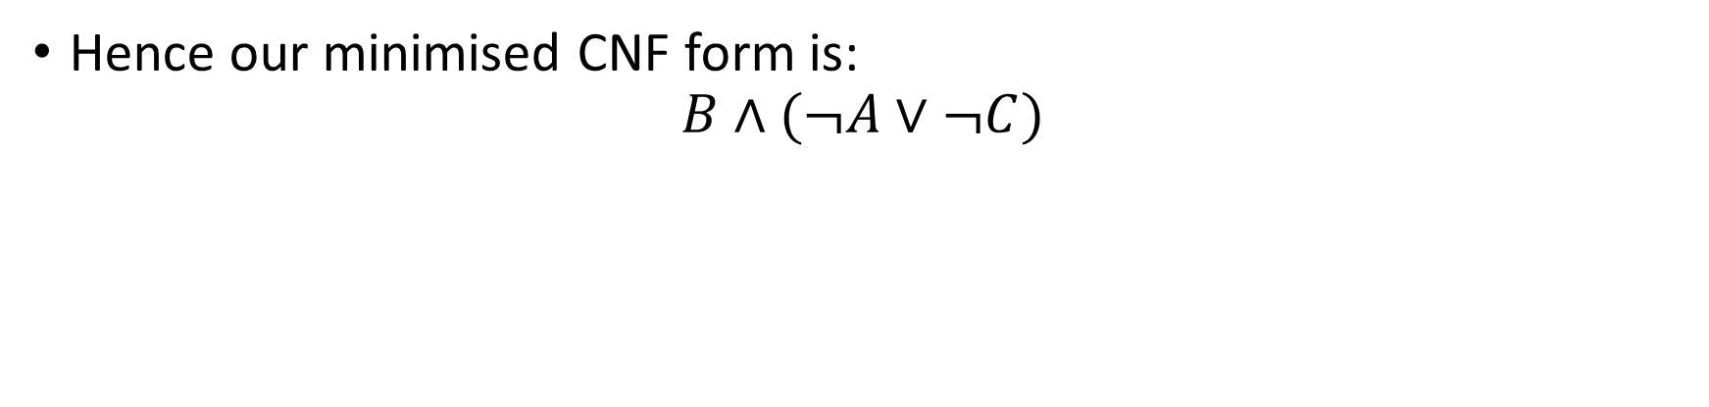
Example 2: CNF form
A BC | 00 | 01 | 11 | 10
0 | 0 | 0 | 1 | 1
1 | 0 | 0 | 0 | 1
Hence our minimised CNF form is:
$$B∧(¬A∨¬C)$$

Slide 37
Example 3: CNF
AB CD | 00 | 01 | 11 | 10
00 | 0 | 0 | 1 | 1
01 | 0 | 0 | 1 | 1
11 | 1 | 0 | 1 | 1
10 | 0 | 0 | 1 | 1
Enclose groups of 0’s

Slide 38
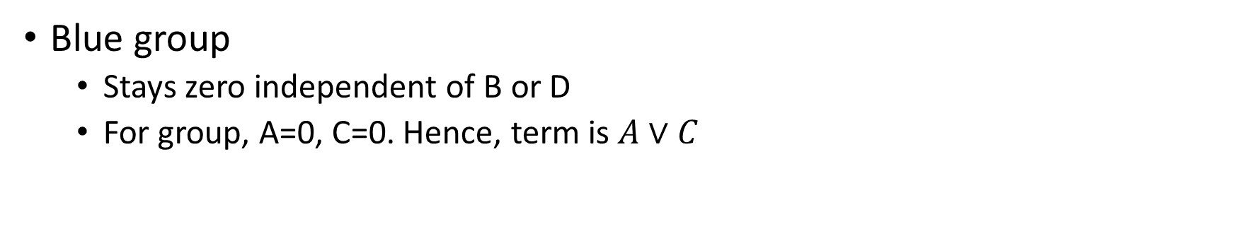
Example 3: CNF
AB CD | 00 | 01 | 11 | 10
00 | 0 | 0 | 1 | 1
01 | 0 | 0 | 1 | 1
11 | 1 | 0 | 1 | 1
10 | 0 | 0 | 1 | 1
Blue group
  Stays zero independent of B or D
  For group, A=0, C=0. Hence, term is $A∨C$

Slide 39
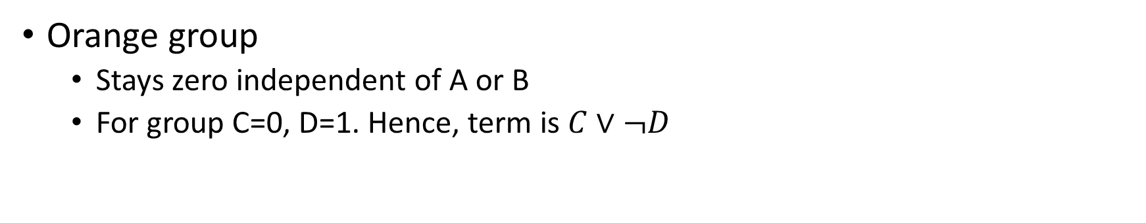
Example 3: CNF
AB CD | 00 | 01 | 11 | 10
00 | 0 | 0 | 1 | 1
01 | 0 | 0 | 1 | 1
11 | 1 | 0 | 1 | 1
10 | 0 | 0 | 1 | 1
Orange group
  Stays zero independent of A or B
  For group C=0, D=1. Hence, term is $C∨¬D$

Slide 40
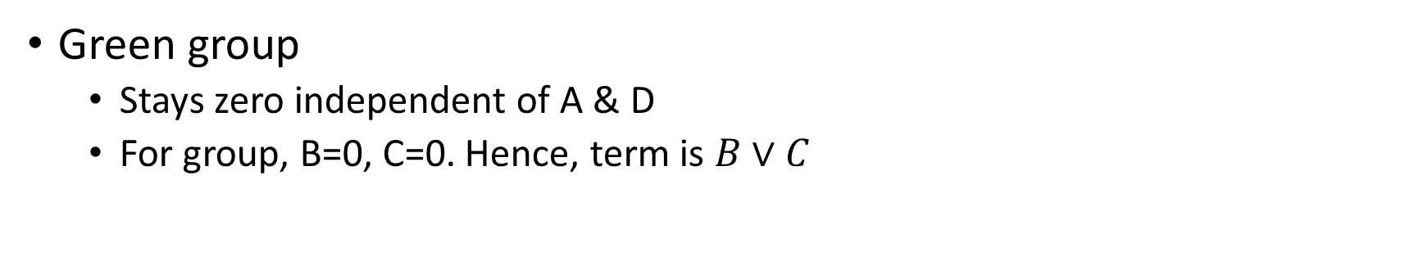
Example 3: CNF
AB CD | 00 | 01 | 11 | 10
00 | 0 | 0 | 1 | 1
01 | 0 | 0 | 1 | 1
11 | 1 | 0 | 1 | 1
10 | 0 | 0 | 1 | 1
Green group
  Stays zero independent of A & D
  For group, B=0, C=0. Hence, term is $B∨C$

Slide 41
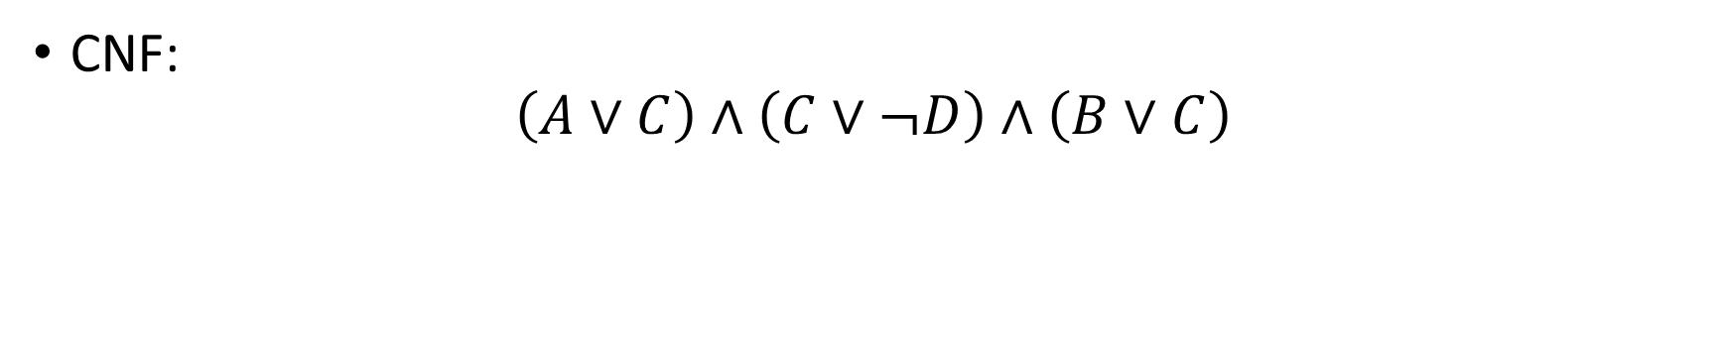
Example 3: CNF
AB CD | 00 | 01 | 11 | 10
00 | 0 | 0 | 1 | 1
01 | 0 | 0 | 1 | 1
11 | 1 | 0 | 1 | 1
10 | 0 | 0 | 1 | 1
CNF:
$$\left(A∨C\right)∧\left(C∨¬D\right)∧\left(B∨C\right)$$

Slide 42
Exercise 2
Minimize the Boolean expressions represented by the following Karnaugh Maps in CNF form:
A BC | 00 | 01 | 11 | 10
0 | 1 | 0 | 0 | 1
1 | 0 | 1 | 1 | 1
AB CD | 00 | 01 | 11 | 10
00 | 1 | 1 | 1 | 1
01 | 1 | 1 | 1 | 1
11 | 0 | 0 | 1 | 1
10 | 0 | 0 | 1 | 1

Slide 43
Summary
Karnaugh Maps

